Slide 1
Data Science Capstone Project
Analysis of Neighborhoods while Moving to a New City

Slide 2
Introduction to business problem
In today’s world, people relocate to new cities for various reasons like higher studies, job opportunities etc.
When someone decides to move to any new city, it will be good for them to get an idea about the neighborhoods in that city, how safe those neighborhoods are and what kind of venues they have like restaurants, supermarkets, shopping places, fitness centers or parks and beaches etc.
In this project, we are going to analyze the community areas in Chicago.
One can replicate this analysis for any other city provided they have the required data sources.

Slide 3
Data Sources
List of all community areas in Chicago:
This list of community codes, community area name and neighborhoods in
each area is available on Wikipedia.
Link : https://en.wikipedia.org/wiki/Community_areas_in_Chicago
Crime Database to identify type of crimes reported in Chicago:
This data is available on Chicago Data Portal. Below is the link for the same.
https://data.cityofchicago.org/Public-Safety/Crimes-2001-to-present/ijzp-q8t2
(We have applied filter as year > 2016 while downloading the data for this
project.)
Foursquare API:
We will use Foursquare API to get the information about available venues around
community areas in Chicago.

Slide 4
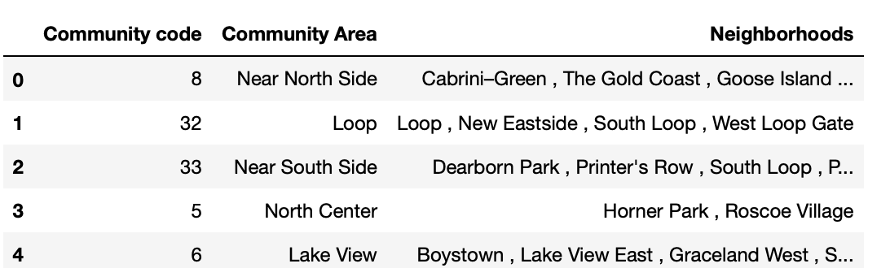
Data Wrangling
Dataset for community areas and neighborhoods:
We have performed web scrapping using Python library Beautiful Soup and prepared a pandas dataframe to store information about community areas in Chicago.
Below is the snapshot of first five rows of the dataframe.
For some of the rows where neighborhoods value was blank, we have assigned neighborhood same as community area.
There are total 77 community areas in Chicago.

Slide 5
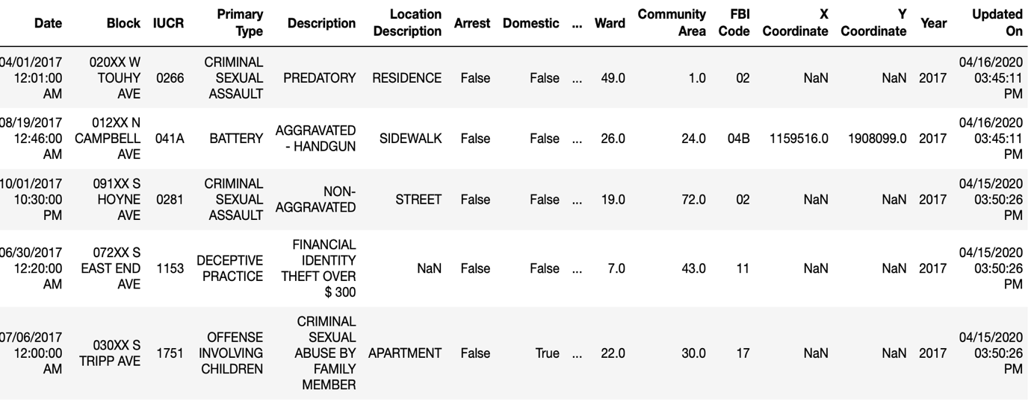
Dataset for Chicago crime data:
CSV file for crime data was read into a pandas dataframe.
There were few cells with ‘NaN’ i.e. ‘Not a Number’ values. We have removed such data from the dataframe.
Below is the snapshot of first five rows of pandas dataframe containing crime data.

Slide 6
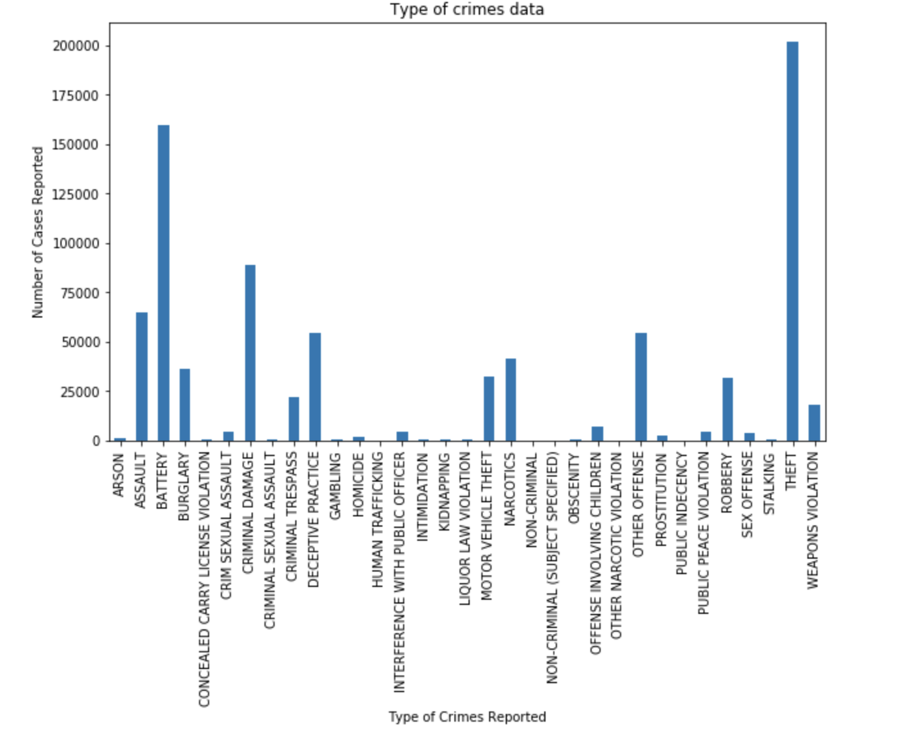
Crime data analysis
Different types of crimes are reported in Chicago area.
We have created a bar plot to get an idea about different types of crimes and for what types of crimes maximum number of cases are reported.
As we can see, top 5 types of crimes are Theft, Battery, Criminal Damage, Assault and Deceptive practice in decreasing order of number of cases reported.

Slide 7
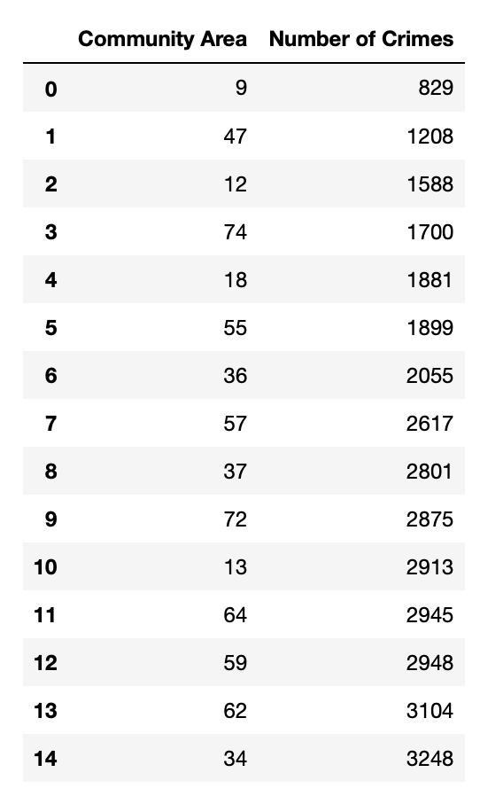
To find out comparatively safer community areas in Chicago.
We have arranged the data in ascending order of total number of crimes reported in each community area and could find the list of safer community areas as 9, 47, 12, 74, 18, 55, 36, 57, 37, 72, 13, 64, 59, 62, 34.

Slide 8
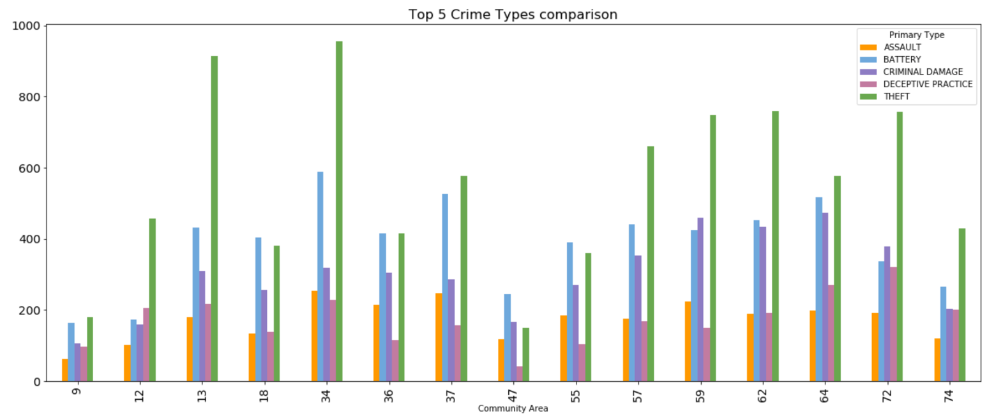
Now that we know top 5 types of crimes reported in Chicago and also 15 comparatively safer community areas, we will check for number of cases for these 5 crime types reported in safer community areas.
Here is the bar plot showing the required information.

Slide 9
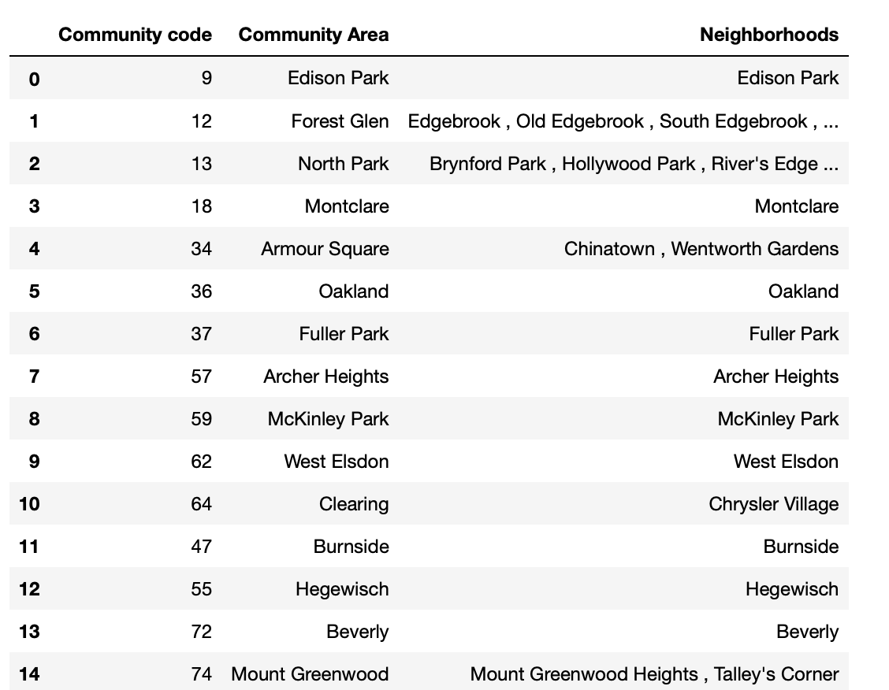
Community Areas Analysis Using Foursquare API
In crime dataset, we have only community codes information, therefore now using the community areas dataset we prepared using Wikipedia page information, we will get the dataset showing community codes, community areas and Neighborhoods for safer community codes identified during analyzing crime data.
Here is the snapshot for the same.

Slide 10
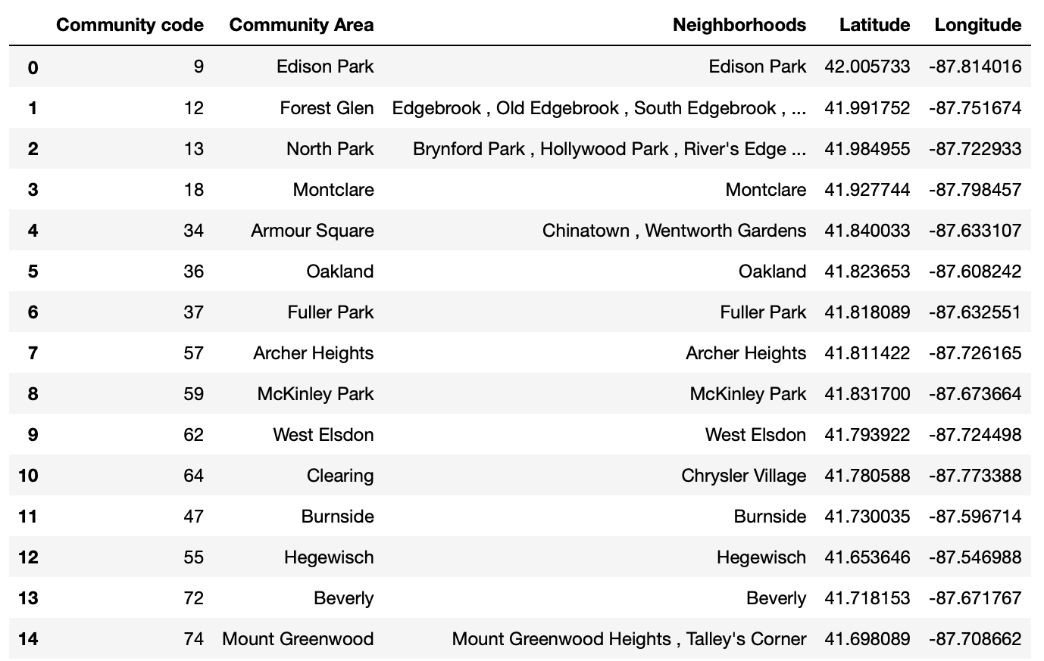
To be able to use Foursquare API for further analysis, we also need to get the location coordinates for community areas.
We used Geopy client for geocoding web-services to get the locations for all safer community areas.

Slide 11
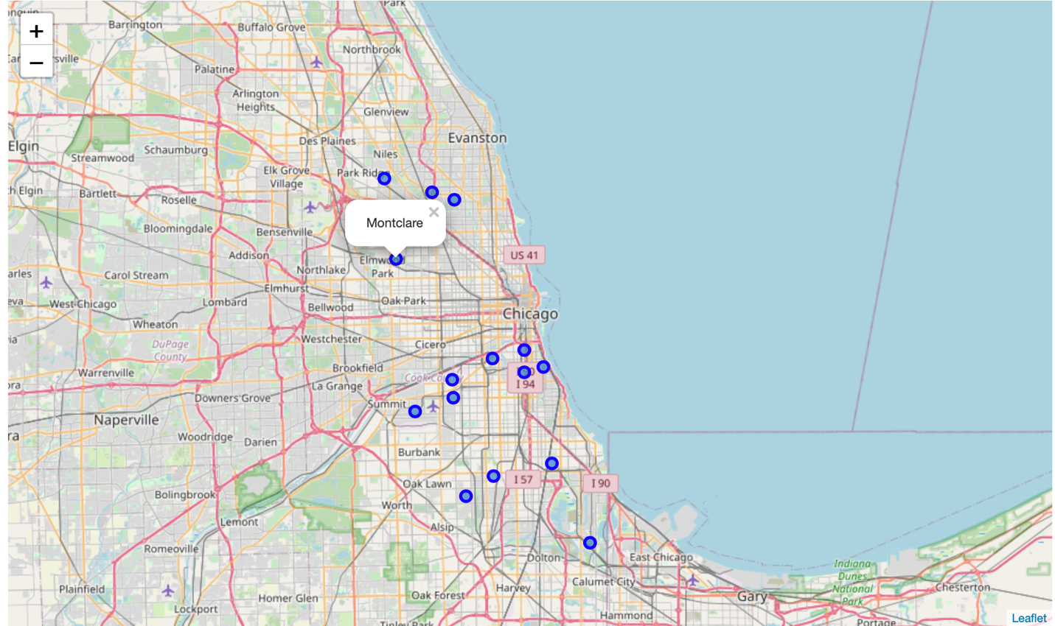
Below is the folium map for Chicago with safer community areas plotted over it.

Slide 12
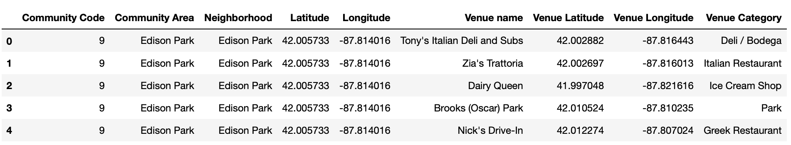
After collecting the location coordinates information for safer community areas, we used Foursquare API to get the venues around each of these community areas.
To get the venues information around a location, we need to pass a search query for venue categories along with Client ID and Client secret key, latitude and longitude of location, Radius value in which search need to be done and Limit value which decides how many venues to return for the location.
Client ID and secret key is available for those who have Foursquare account.
We have set radius = 5000 and Limit = 100.
Sample venue data we received for community areas using Foursquare API is as below:
There are 195 unique venue categories returned using above mentioned radius and limit around safer community area locations.

Slide 13
We could get top 10 most popular venue categories for community areas after performing some technical analysis over the data returned by Foursquare API.

Slide 14
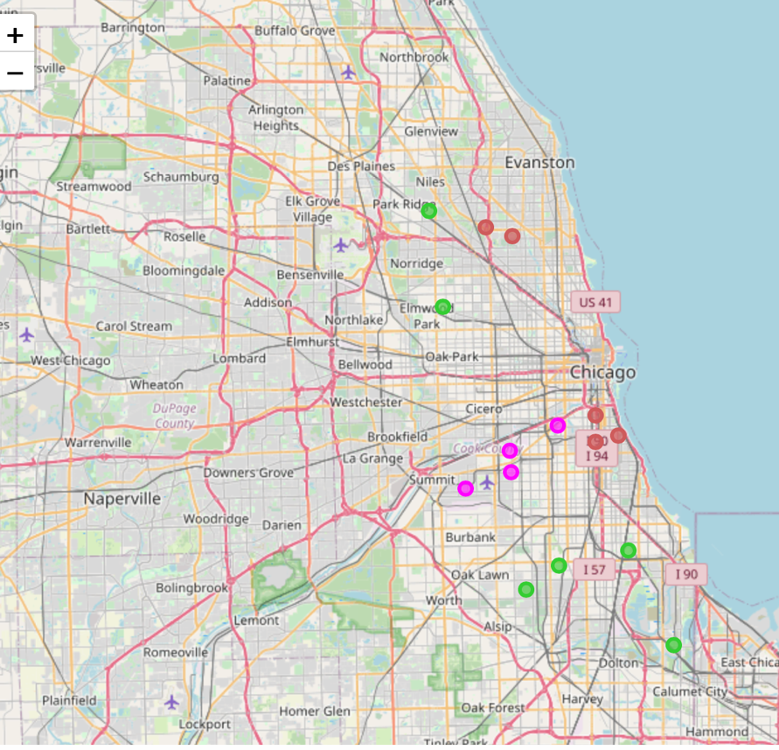
Cluster Analysis using Machine learning algorithm K-means
We have collected the most popular venue categories around each safer community area in Chicago.
We divided these areas into clusters using popular unsupervised machine learning algorithm K-means.
We have performed clustering by setting number of clusters = 3, As a result we get labels as Cluster 0, Cluster 1 and Cluster 2.
Using Folium, we plotted these clusters with specific color code for each cluster on map of Chicago city.

Slide 15
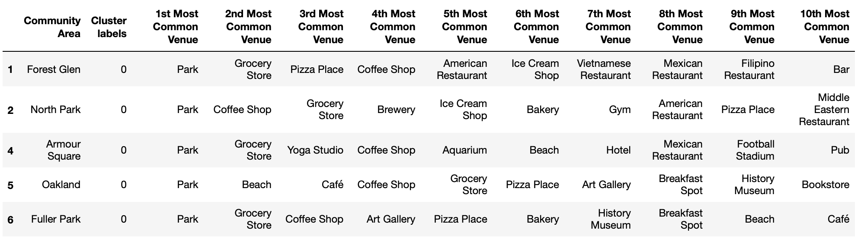
Observations of Cluster analysis
We have included cluster labels as columns in our dataframe containing top 10 most popular venues for each community area.
Cluster 0:
As we can see, 1st most common venue for community areas under cluster 0 is Park.
Then we have grocery store, pizza place and coffee shops in each area.
Three of the five areas have beach while two of the five have Breakfast spots.
Either Yoga studio or gym or park are present in each area if someone is interested in regular fitness activities.
For people interested in Arts and History, there are Arts galleries and History museums.

Slide 16
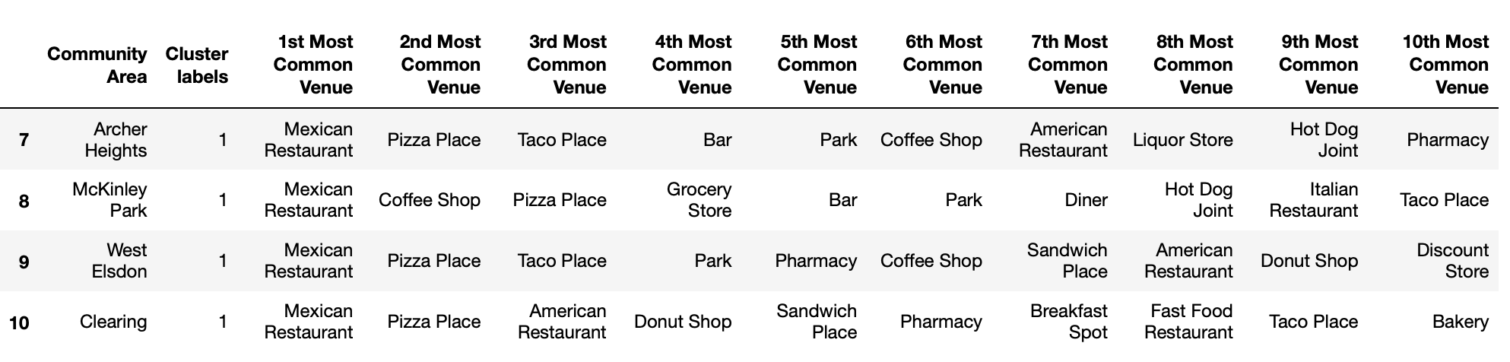
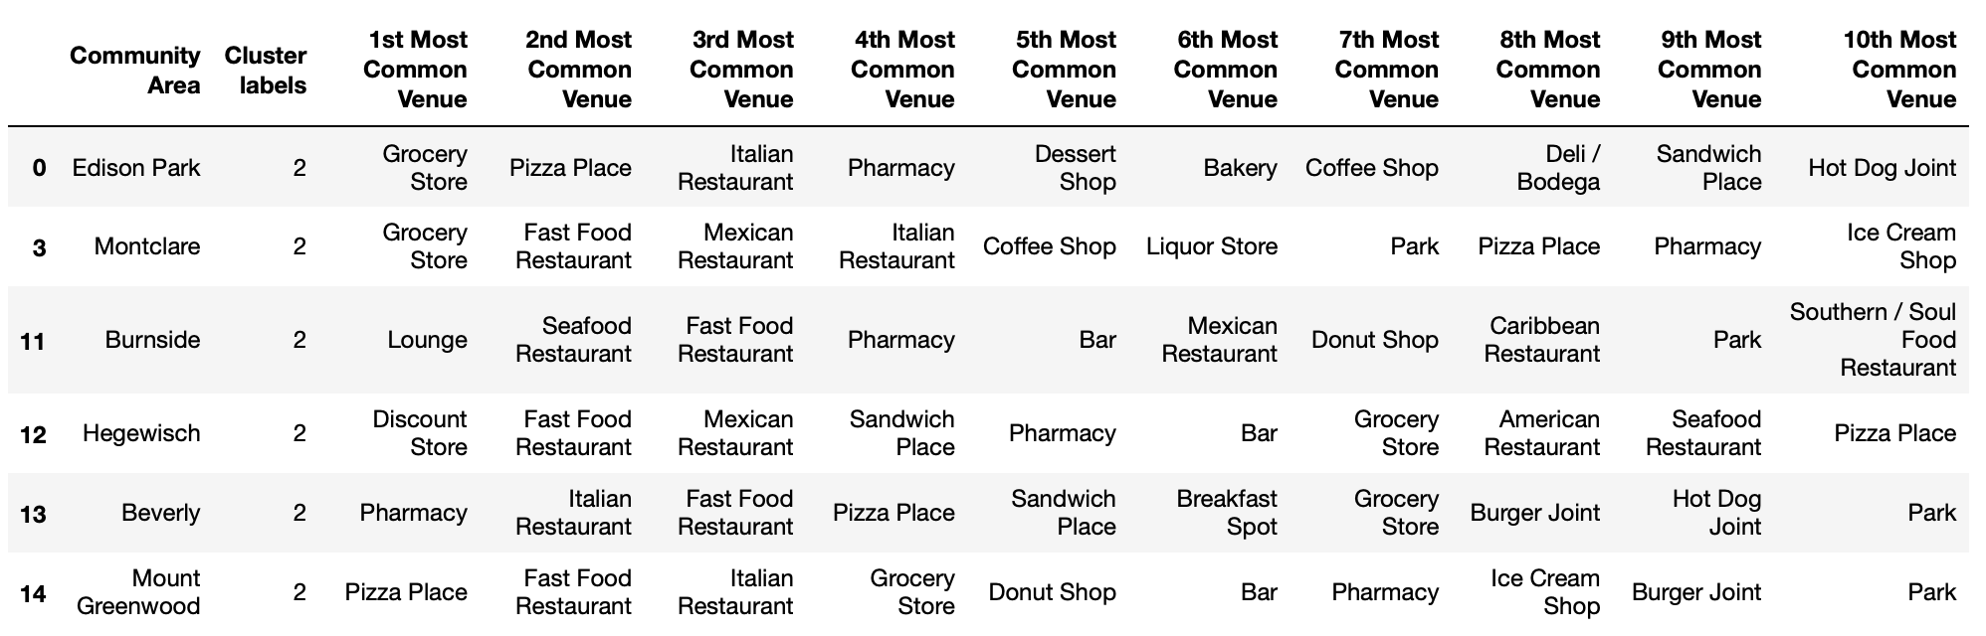
Cluster 1:
As one can clearly observe that cluster 1 areas have Mexican restaurants, Pizza places and taco places as their most common venues.
Cluster 2:
Cluster label 2 has Pharmacy and grocery store as most common venues. Apart from these two, we have Fast Food Restaurant, Italian Restaurant and Mexican restaurant as another most common venue categories.

Slide 17

Conclusion
After analyzing the clusters, we can conclude that areas in cluster 1 i.e. with cluster label = 0 have good combination of venues such as restaurants, grocery stores, beach, park, fitness activity centers(Yoga Studio and Gym), and it also has Art galleries and museum. So it covers most of the interests one might have.
Here, we considered Chicago as a new city but this approach can be followed for any other city and one will be able to choose the neighborhoods around any city depending on one’s interests.

